Slide 1



Diabetes Exploratory Data Analysis: Dashboard
View in Power BI

Slide 2
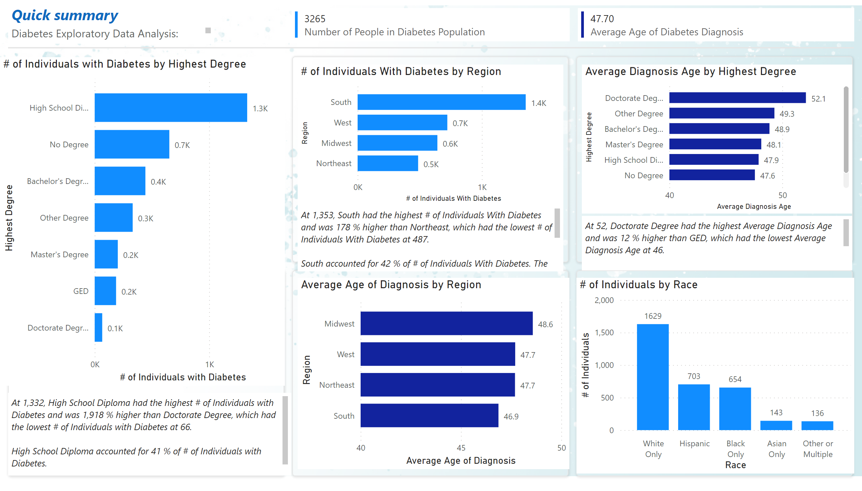
Page 1
Notes:
multiRowCard
No alt text provided
clusteredBarChart
No alt text provided
clusteredBarChart
No alt text provided
clusteredBarChart
No alt text provided
clusteredBarChart
No alt text provided
shape
No alt text provided
shape
No alt text provided
shape
No alt text provided
shape
No alt text provided
shape
No alt text provided
textbox
No alt text provided
textbox
No alt text provided
multiRowCard
No alt text provided
shape
No alt text provided
columnChart
No alt text provided
textbox
No alt text provided
textbox
No alt text provided
textbox
No alt text provided

Slide 3
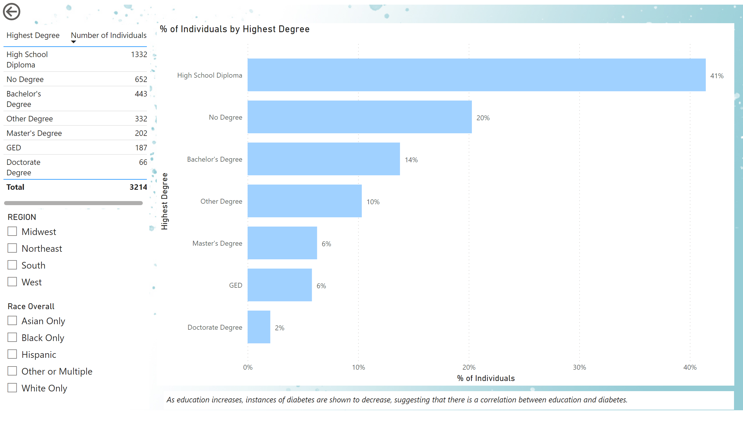
Page 2
Notes:
tableEx
No alt text provided
clusteredBarChart
No alt text provided
actionButton
No alt text provided
slicer
No alt text provided
slicer
No alt text provided
textbox
No alt text provided

Slide 4
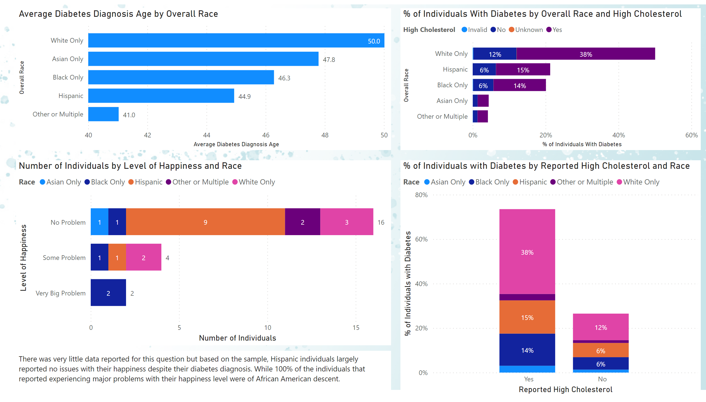
Page 3
Notes:
columnChart
No alt text provided
barChart
No alt text provided
textbox
No alt text provided
barChart
No alt text provided
barChart
No alt text provided

